Slide 1

Project Brave New World
An Exploration of Robotic Scouting
and Communication Techniques in
Swarm vs. Search Party Paradigms

Slide 2
Overview
Scenario
Environment
Animat Design
Experiments
Results
Discussion

Slide 3
Scenario
Efforts for robotic exploration
Need effective techniques for exploring, assessing, and colonizing distant planets
We seek to explore the explorers by ranking various robotic scouting techniques
Efficiency (speed of finding vital resources)
Robustness (finding resources before running out of power or breaking down)
Operation in a communication and visibility inhibited environment

Slide 4
Development
StarCraft II Map Editor
Handles graphics, physics
Multi-level terrain height
Custom models
Event handlers
User interfaces
Trial tracking
Scout neural net states
Exploration stats

Slide 5
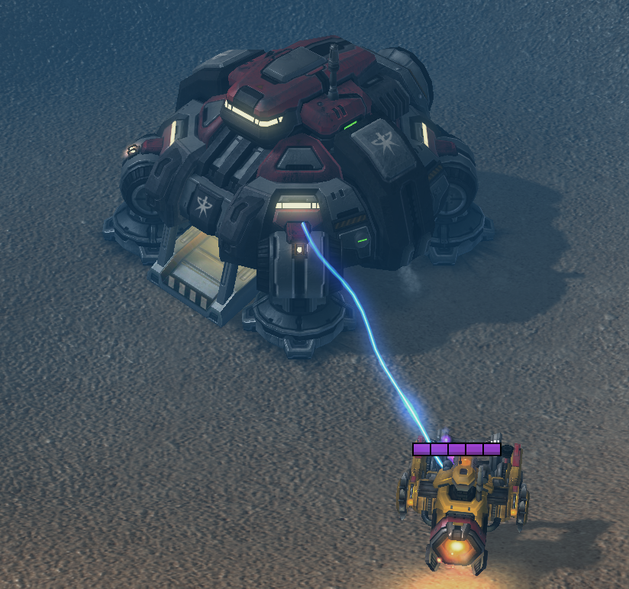
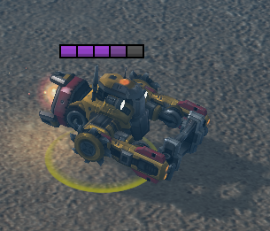
Environment
Scouts
Home Base
Charging
Central Data Storage

Slide 6
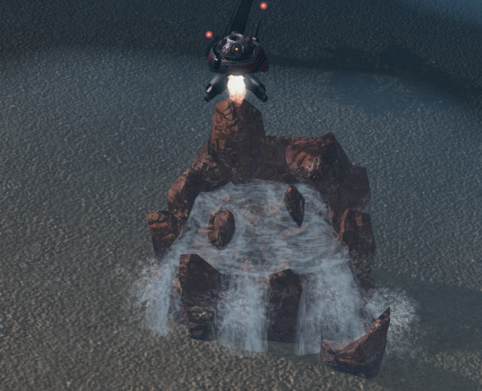
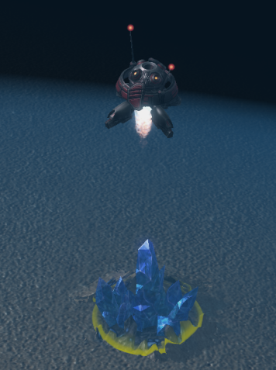
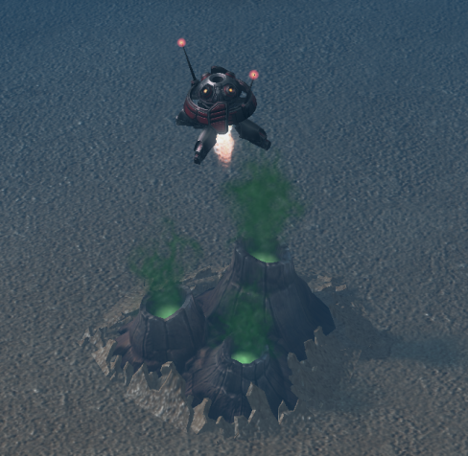
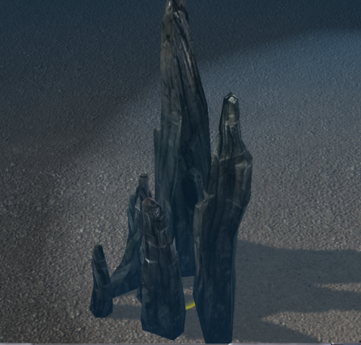
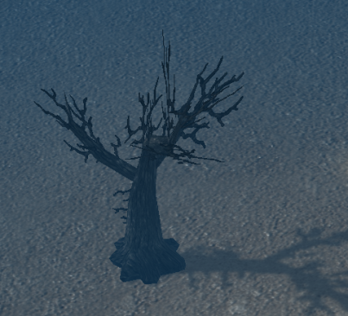
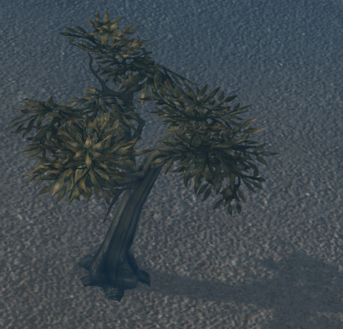
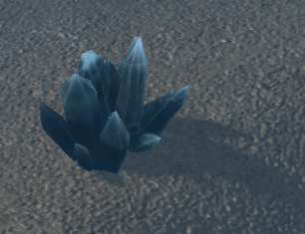
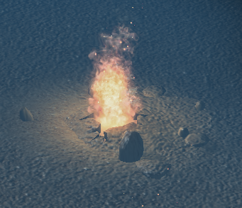
Environment
Resources and Cues
Gas, Water, Minerals (30 on map spawned randomly)
Cues spawned in proximity of resources (5 / resource)
Distractors spawned randomly away from resources (75)
Marked Resources (top) and Cues (bottom)
Distractors

Slide 7
Animat Design
Movement
Using two thrusters to hover (velocity = 3m / sec)
Any direction
Sensors
Vision
360° camera system: 8m vision radius
Communication
Short range radio frequency broadcast and receiver: 8m radius

Slide 8
Animat Design
Movement Direction
Random choices (while exploring, 10m / step)
Trend towards learned environmental cues
Search parties move together (in some conditions)
Resource Marking
Resources discovered visually (within 8m)
Marked with beacon
Battery Life
Battery has 100 units of charge
Atrophies at a stochastic rate of 2 – 4 units / step

Slide 9
Animat Design
Brain Structure
Neural Net decision making based on:
Adjacent cues (is that cue usually near a resource, and therefore, should I go towards it?)
Current battery life (is my battery life low enough that I need to return to base?)
Experimental condition (discussed in depth later)
Do I need to mine that resource?
Do I need to return to my search party?

Slide 10
Animat Design
Brain Structure
Short Term Memory (STM): a score that evaluates how recently a particular cue was seen, and atrophies over time
Long Term Memory (LTM): if a cue was recently seen (nonzero STM for a particular cue)…
…and a resource is found, positively associate that STM cue with finding a resource (LTM increases for cue)
…and no resource is found, begin to negatively associate that STM cue with finding a resource (LTM slowly decreases for cue)

Slide 11
Animat Design
Communication
Requires sufficient proximity
Each other
Home Base
Transfer learned associations
Between environmental cues and resources
The communicating bot with the higher confidence in a learned association (higher LTM value for that cue) is more influential in the communication weighting

Slide 12
Completed Development
0. Random scouting [Baseline performance]
Scouts mark found resources
Scouts can recharge at base but will not actively seek it if they need to
Scouts explore individually
No communication between scouts

Slide 13
Completed Development
Non-communicating Swarm [Control]
Scouts use Long Term Memory and Short Term Memory to create associations between resources and cues
Scouts mark found resources
Scouts willfully return to base to charge
Scouts explore individually
No communication between scouts

Slide 14
Completed Development
Non-communicating Swarm with Location Memory
Scouts use Long Term Memory and Short Term Memory to create associations between resources and cues
Scouts mark found resources
Scouts willfully return to base to charge
Scouts explore individually
Scouts remember their last location before going to charge, and return to that location afterwards
No communication between scouts

Slide 15
Experiments
All experiments consist of:
10 trials
5 minutes each
Experiment 1
Random resource discovery
Experiment 2
Neural net resource discovery
Experiment 3
Neural net resource discovery with location memory

Slide 16
Results
Experiment (n = 10) | Mean Resources | SD of Resources
Experiment 1 (Completely random) | 5.90 | 2.28
Experiment 2 (Neural Net alone) | 8.80 | 2.04
Experiment 3 (Neural Net + Location Memory) | 11.50 | 2.51

Slide 17
Future Directions
Communication: scouts will share what they’ve learned and hypothetically find resources more quickly
Structured search parties: scouts move as a group and periodically branch off
Home Base communication: home base can communicate like a scout
Mining: dependent variable is how much of a resource the scouts can mine

Slide 18
Discussion
Difficulties
Neural net design
Weighting of Short Term Memory on Long Term Memory changes
STM and LTM atrophy weights
StarCraft II Map Editor
Need to use creative means of accomplishing neural net
Using Long Term Memory to influence movement direction
Trending towards a cue = reducing probability of moving away from it by strength of LTM association

Slide 19
Demo

Slide 20
Andrew Forney
Ben Harounian
{benh|forns}@cs.ucla.edu
UCLA Computer Science 263C Winter 2013
Professor Michael Dyer
Tuesday March 12, 2013
Special Thanks:
Blizzard

